Slide 1
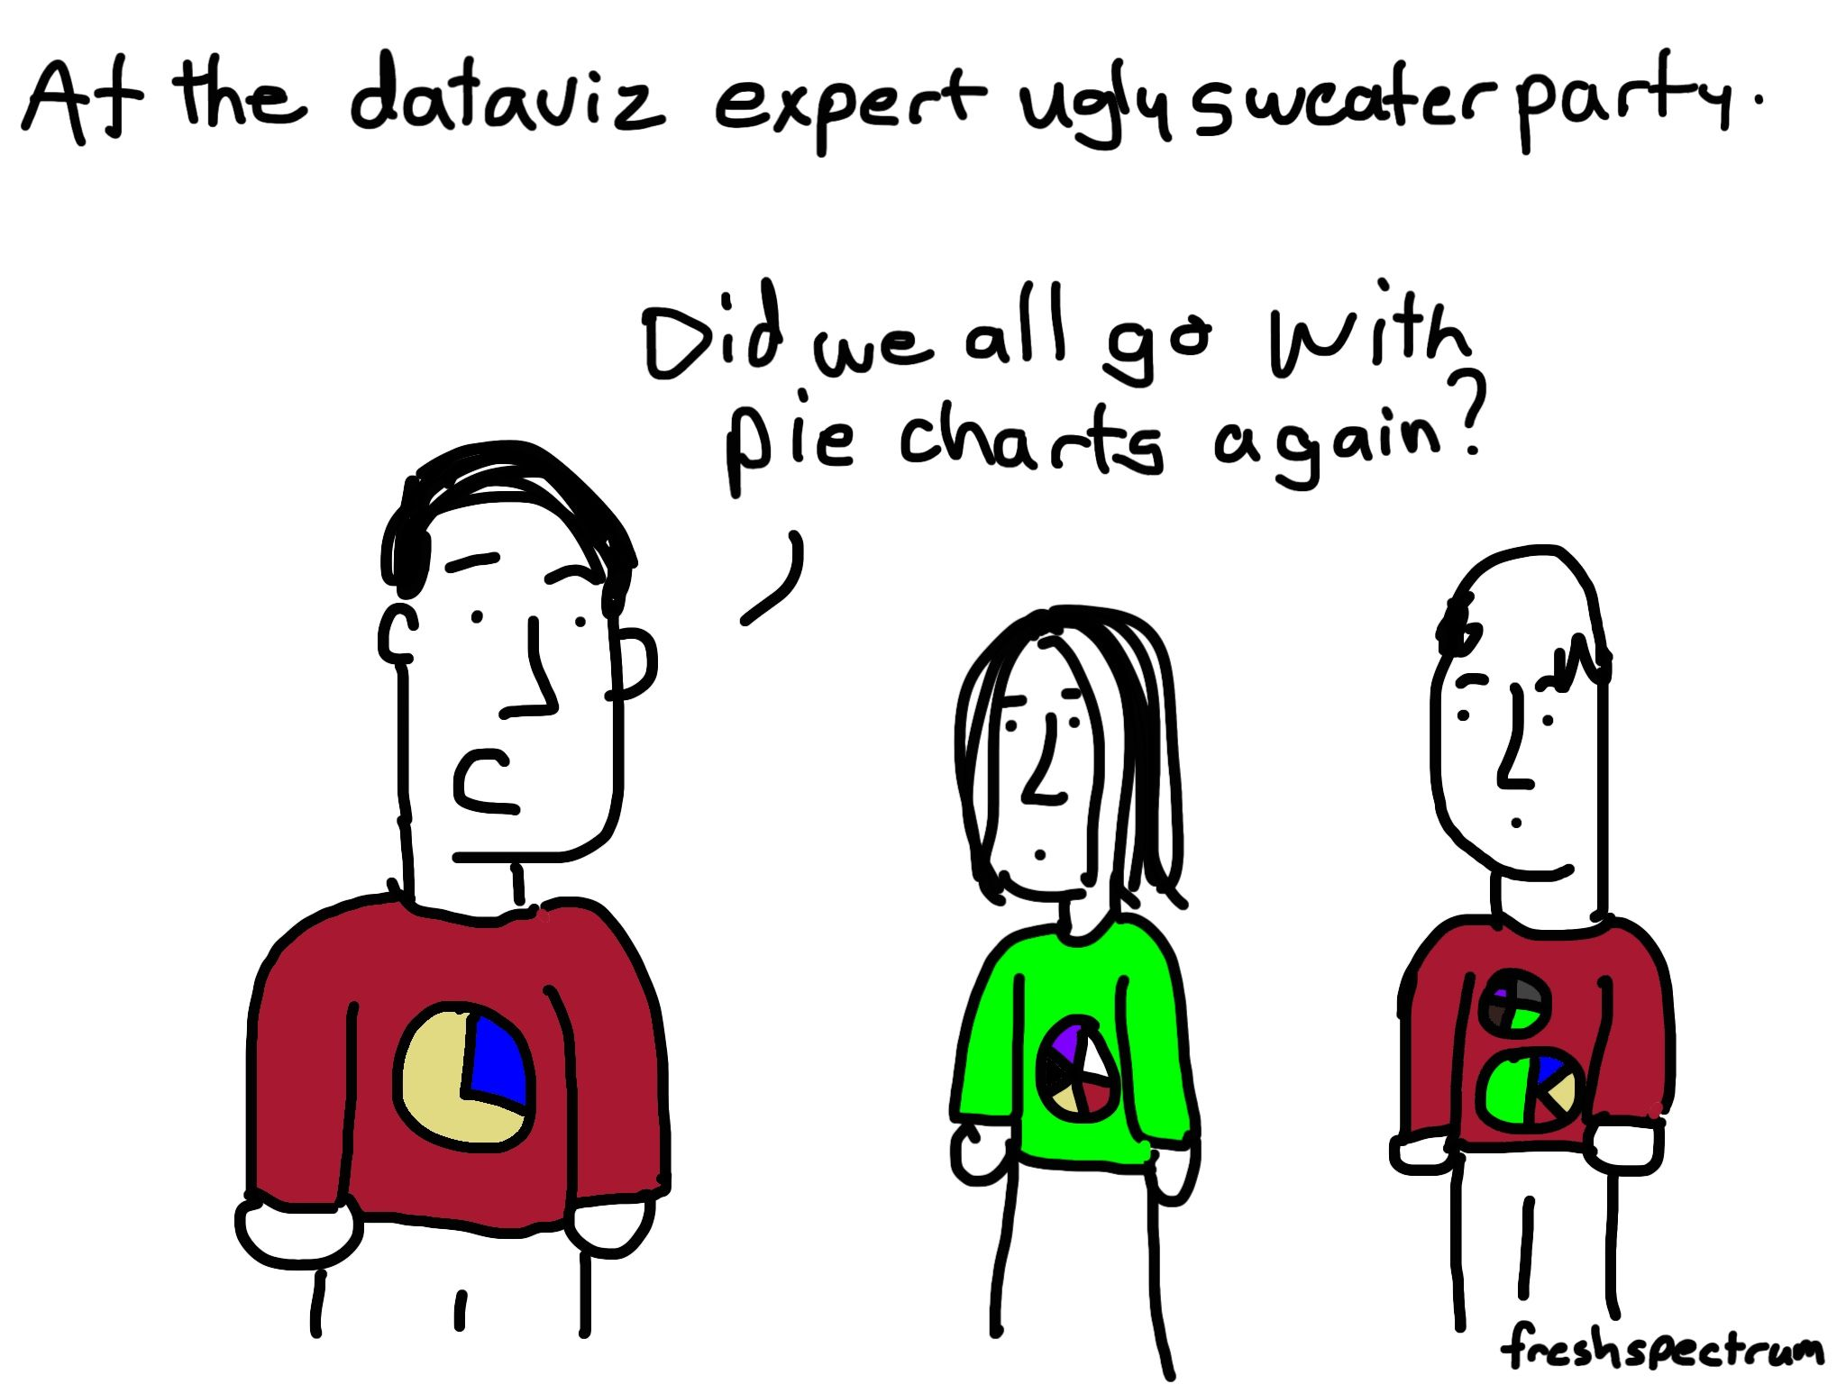
Source

Slide 2
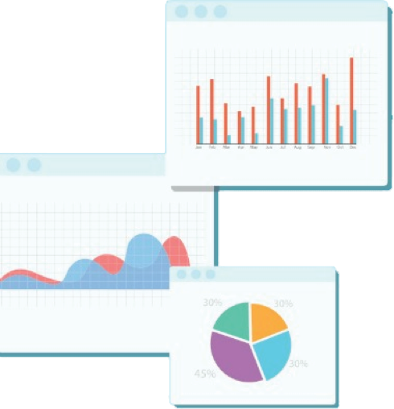

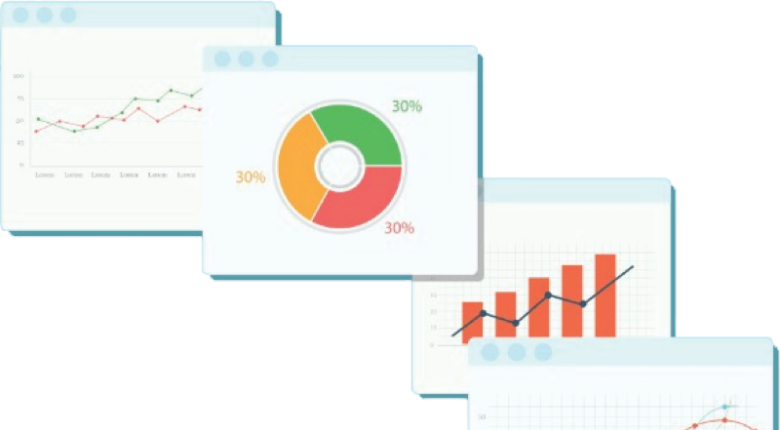
Welcome to Week 4
Lecture 1!
Data Science in Python &
Machine Learning

Slide 3
Learning Goals:
By the end of this less you will be able to:
1. Know the end-of-stack expectations
2. Explain the difference between exploratory and explanatory visualizations
3. List 3 considerations when making an explanatory visualization
4. Create and interpret a visualization and answer a specific question.

Slide 4
Week 4 CORE Assignments
Project 1 - Part 4 (Core)
Must be submitted by Friday, February 18th @ 9 AM PST
Any requested Project 1 - Part 4 resubmissions will NOT prevent you from moving on to Stack 2 next week!

Slide 5
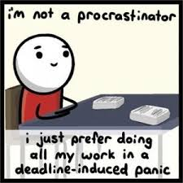
In addition to Passing the Belt Exam,
ALL Core Assignments must be completed by Friday 02/18 by 9 AM PST!
Source

Slide 6
📣Stack 2 Announcement
Coding Dojo’s switching from a single instructor teaching all stacks to each instructor specializing in specific stacks.
For Stack 2, I will be handing over the reigns to Sherlin Whaley, our Machine Learning Instructor!
I will continue to offer bonus Friday office hours/lectures on Fridays during Stack 2.

Slide 7

Explanatory Visualizations Tell a Story
Image Source

Slide 8
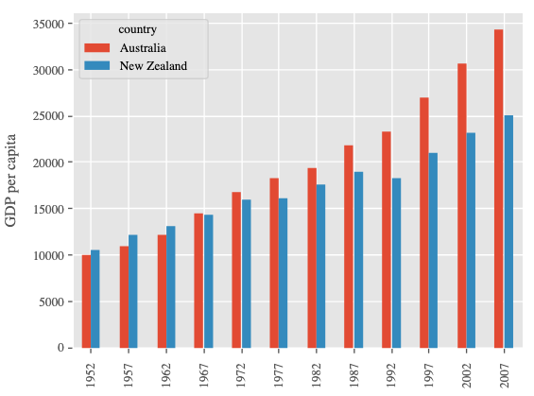
Presentation Graphs Should:
GDP Change Over 50 Years
Have clear answer to a well defined question
‘Is there a correlation between heat and humidity?’
‘Are men or women more likely to buy our product?’
‘How have searches for Pokemon changed over the last 10 years?’
Be clear enough to understand in 5 - 10 seconds
Be visually appealing, but NOT cluttered or distracting
Use shape, color, words, and/or markers to draw attention to what is important
Image courtesy of Software-Carpentry

Slide 9
Know your Audience
Consider:
Technical understanding
Necessary amount of detail
Content of interest

Slide 10
Know your Data
Consider:
Meaning of your features (columns)
Relationships between features
Types of data (numeric or categorical)

Slide 11
Know your Data
Data Relationship | Chart Type
Correlation | Scatter Plot
Distribution | Histograms, Box Plots
Geospatial | Maps
Ranking or Comparison | Bar Charts
Trends | Line Graphs

Slide 12
Know your Goal
Consider:
What question does the image answer?
What you want your audience to get out of your visual?

Slide 13
Know your Resources
Selecting Visualizations
https://www.python-graph-gallery.com/
https://datavizproject.com/
Knowing What is Possible - Example Galleries
https://seaborn.pydata.org/examples/index.html
https://matplotlib.org/stable/gallery/index.html

Slide 14
Explanatory Visualizations Tell a Story
Spend 5 minutes or so to discuss how to improve these graphs.

Slide 15
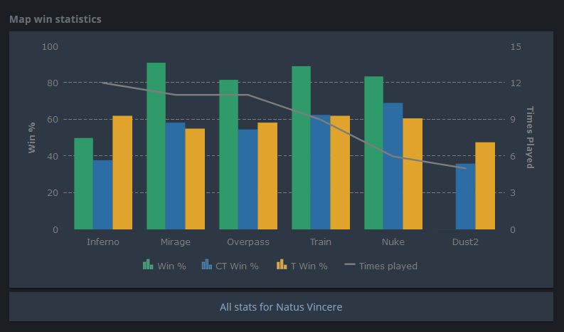

Slide 16
Less is More
Keep your visualization as simple as possible
Understandable in 5-10 seconds

Slide 17
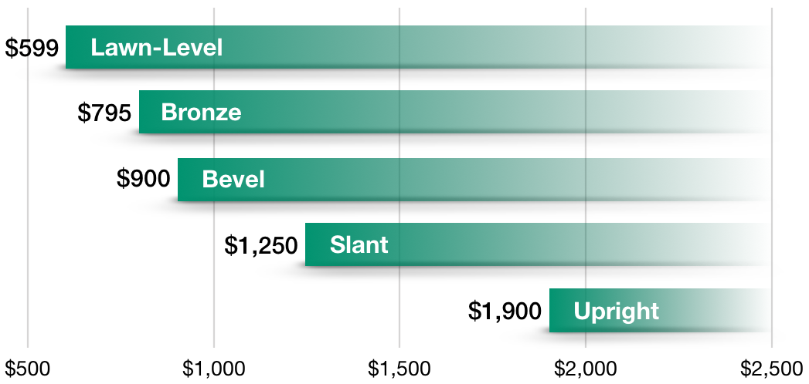

Slide 18
Do not mislead your audience
Always go from left to right

Slide 19
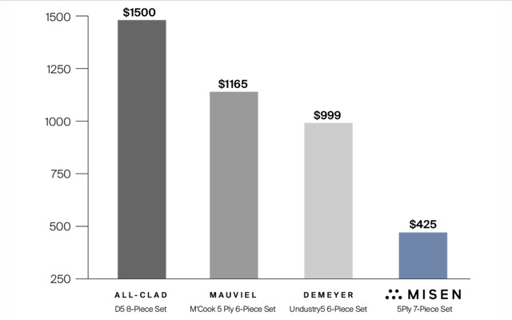

Slide 20
Do not mislead your audience
Do not break axis, always start at 0

Slide 21
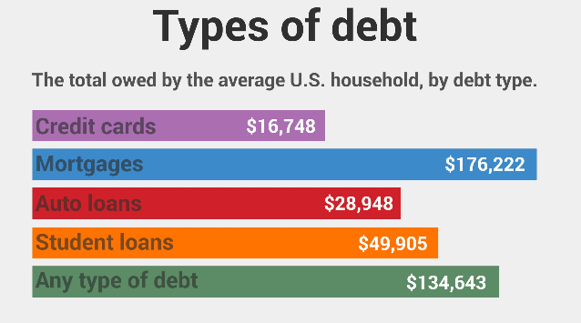

Slide 22
Do not mislead your audience
Keep sizes proportional to their values

Slide 23
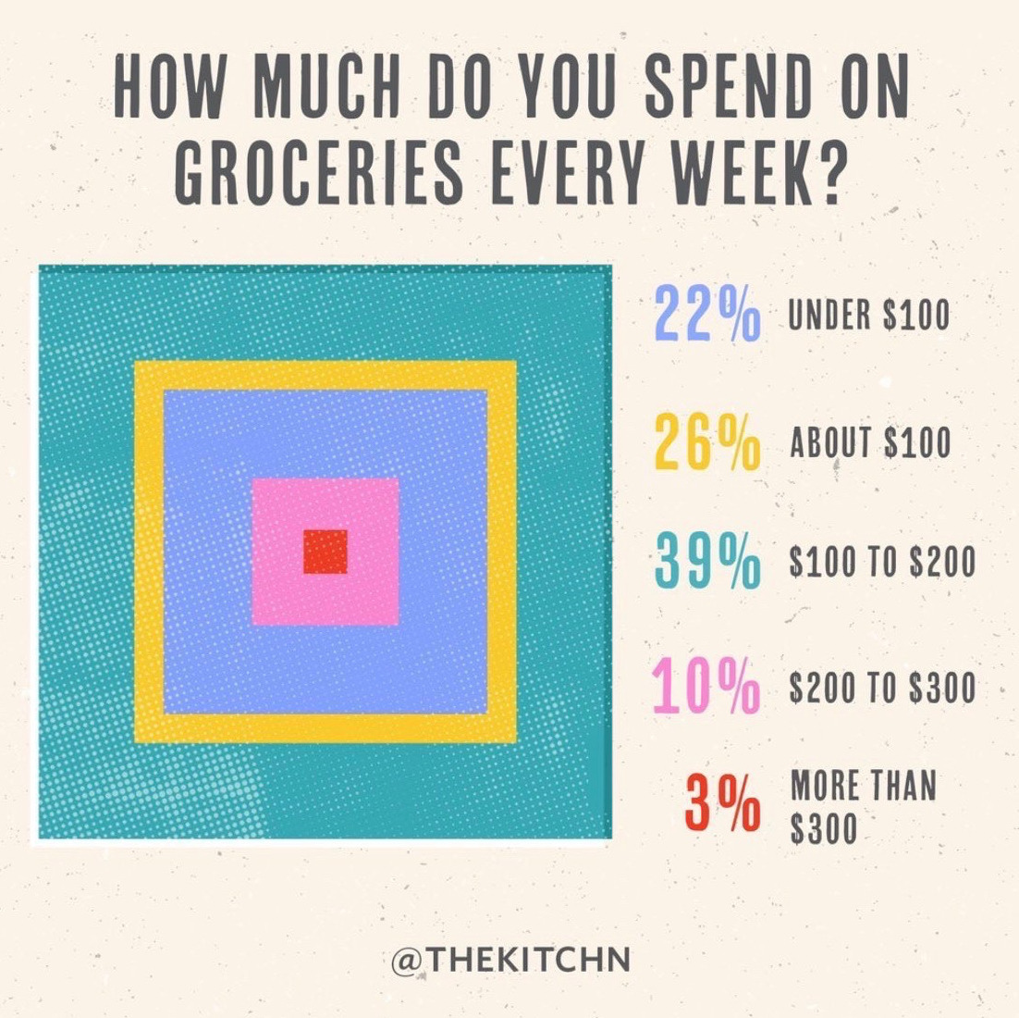

Slide 24
Do not use data visualization to express your creativity!
Keep it simple and clear!

Slide 25
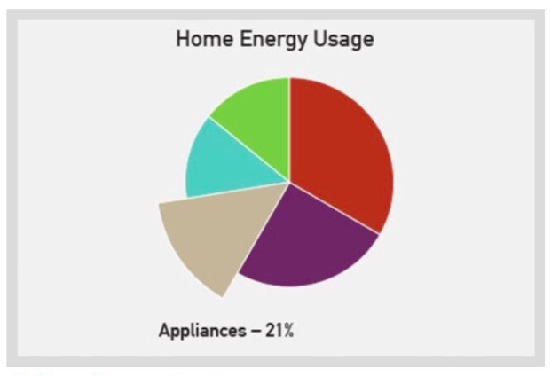

Slide 26
Do not mislead your audience
Stay away from making the reader estimate volumes (avoid 3D graphs)
Stay away from shapes that are hard to estimate areas (yes, this means avoiding pie charts)

Slide 27
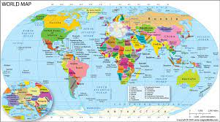
Schooling and Life Expectancy - CodeAlong
Let’s say I want to report on the relationship between education and life expectancy…
The Data:
This dataset shows various statistics for hundreds of countries for 15 years. Each row is one country during one year.
The data is available on Kaggle.
Image source

Slide 28
Schooling and Life Expectancy CodeAlong:
Questions to Answer
Does education increase life expectancy?
Does the development status of a country affect schooling or life expectancy?
How have schooling and life expectancy changed over time?
Our Starter Colab Notebook

Slide 29
Schooling and Life Expectancy
Does education increase life expectancy?

Slide 30
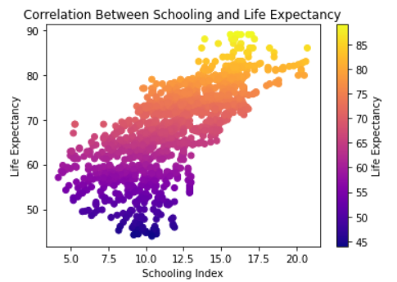
Schooling and Life Expectancy
Does education increase life expectancy?

Slide 31
Schooling and Life Expectancy
Does education increase life expectancy?
Interpretation:
This scatter plot shows a positive correlation between schooling and life expectancy. Nations with better schooling tend to have longer life expectancy.
However, we can’t assume that schooling causes higher life expectancy, just because they are correlated.

Slide 32
Schooling and Life Expectancy
Does the development status of a country affect schooling or life expectancy?

Slide 33
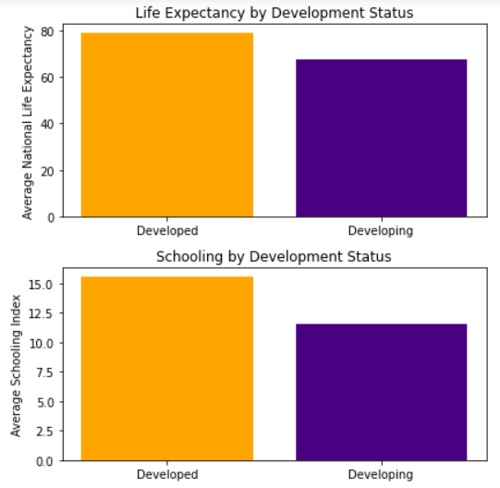
Schooling and Life Expectancy
Does the development status of a country affect schooling or life expectancy?

Slide 34
Schooling and Life Expectancy
Does the development status of a country affect schooling or life expectancy?
Interpretation:
There is a difference in both mean schooling index and life expectancy between developing and developed countries. This may indicate that developed countries either invest more heavily in education, or that education improves the development of countries.

Slide 35
Schooling and Life Expectancy
How have schooling and life expectancy changed over time?

Slide 36
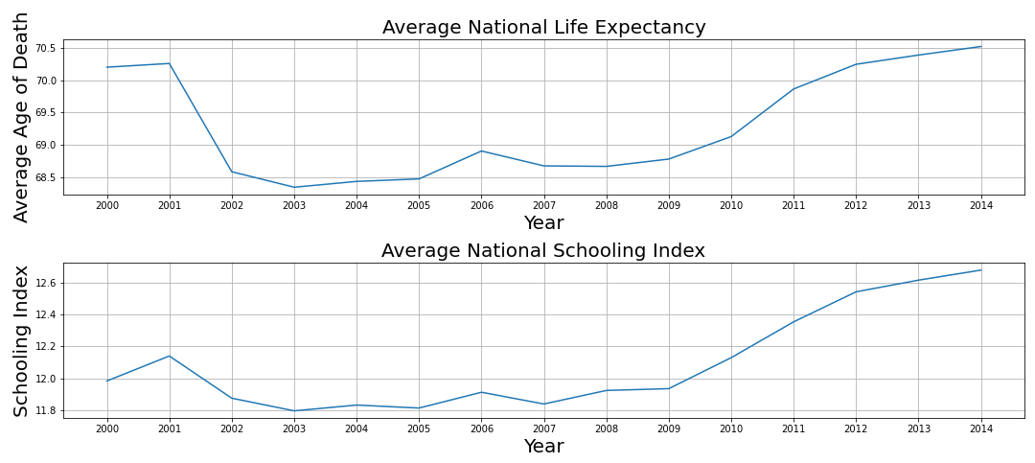
Schooling and Life Expectancy
How have schooling and life expectancy changed over time?

Slide 37
Schooling and Life Expectancy
How have schooling and life expectancy changed over time?
Interpretation:
The life expectancy and schooling both increased between 2000 and 2014. Since schooling index changes seem to follow life expectancy year for year, perhaps schools provide a safe haven for students and reduce deaths.
Recommendation:
Nations should improve access to safe schools in order to raise life expectancy.

Slide 38
Schooling and Life Expectancy
Visualization Source Notebook
Source Notebook

Slide 39
Visualization Topics Saved for Next Class
We are saving much of the visualization aesthetics concepts until Thursday.
Topics saved for next class (if not covered today):
Formatting ticks
Matplotlib styles/seaborn themes
Font customization (titles/axis labels, etc)
Figures with multiple subplots
Multiple subplots with DIFFERENT figure sizes.
Saving/exporting figures (programatically)
Interactive visualizations (if there’s time!)

